Slide 1
特征向量数据库 Milvus

Slide 2
01
Milvus是什么
Notes:
首先，我们要解释一下milvus是什么，或者说，它解决的是什么样的问题：

Slide 3
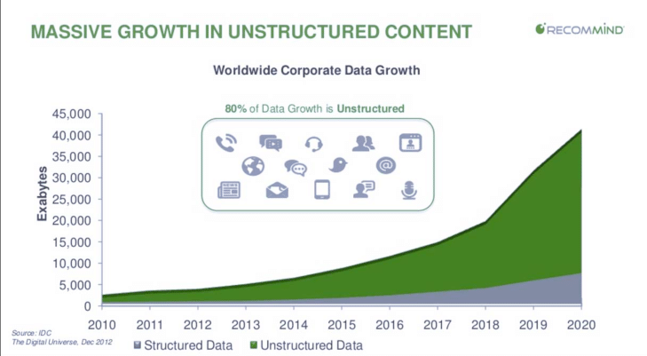
Notes:
这张图是EMC 赞助的一项研究，该研究在2012年，预估2020的数据将会达到的规模会是40EB

Slide 4
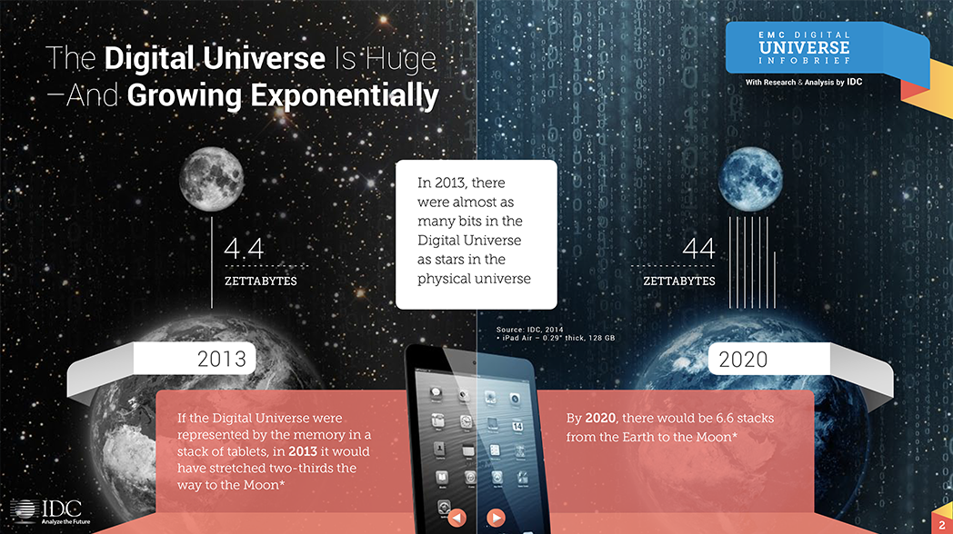
Notes:
一年后，更新的数据则是将这个数据推到了44ZB的规模，而其中，绝大部份的数据，均为非结构化数据。

Slide 5
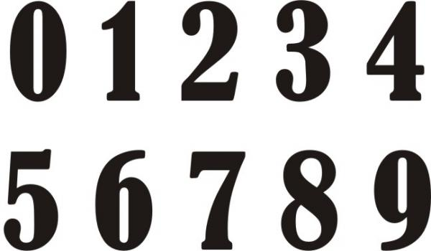
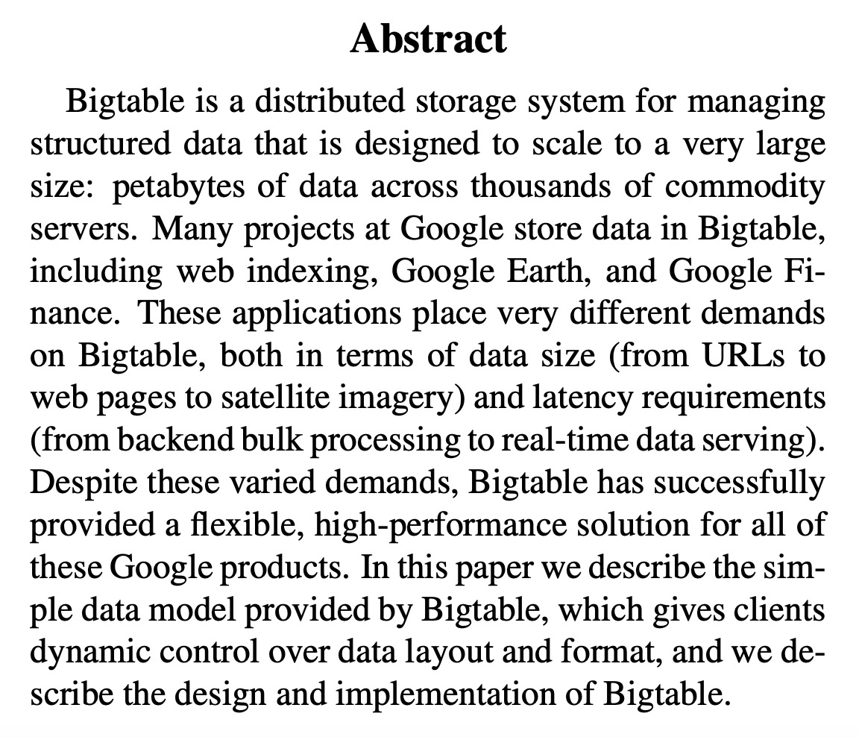
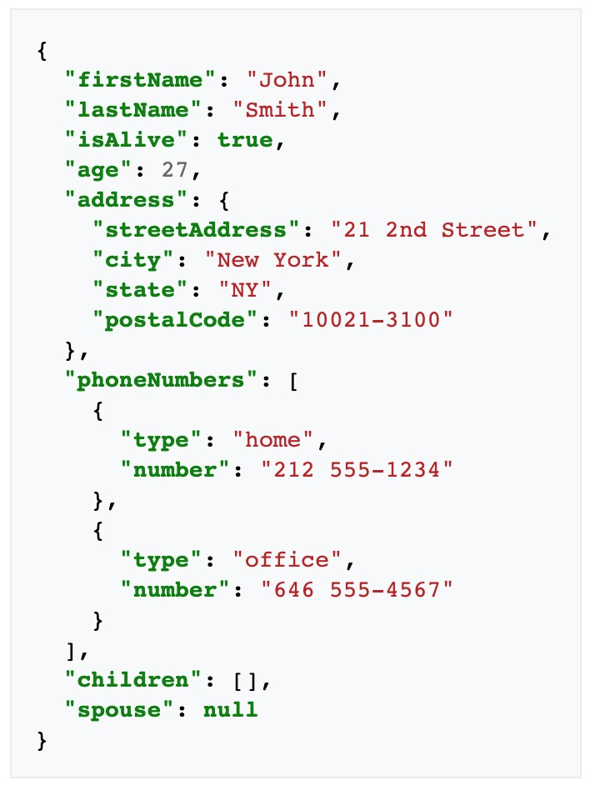

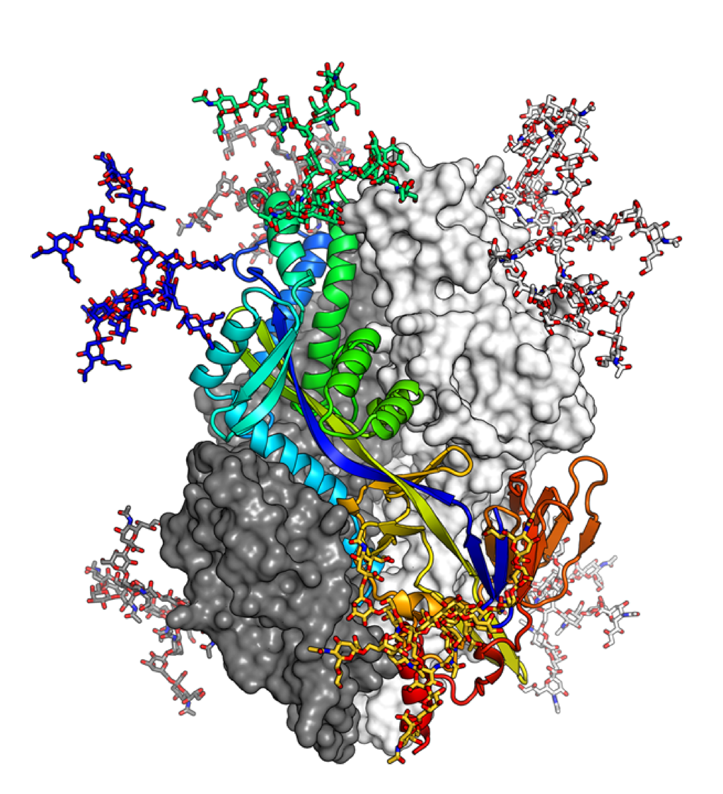
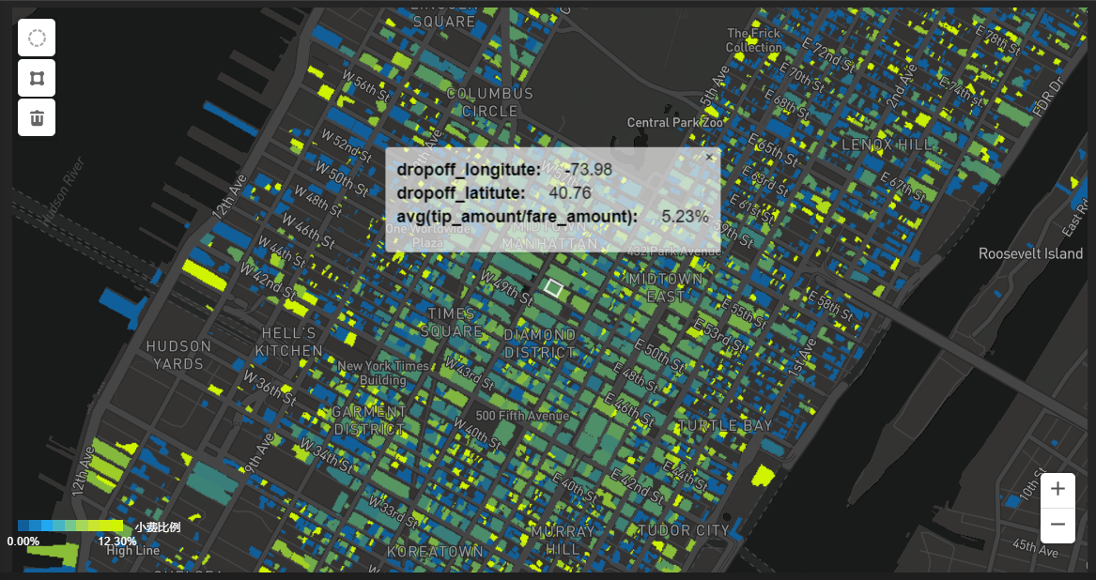


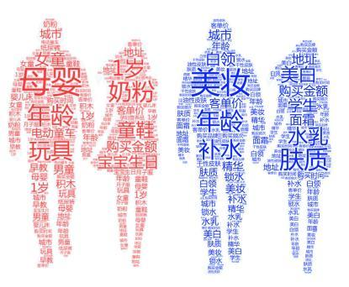

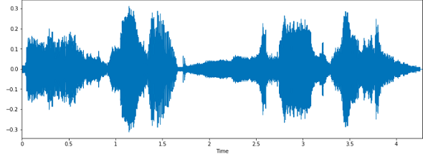
数据横向增长：数据类型
Int, float,
string, …
image
video
audio
text
json
domain specific
ABCDEFG
2021.11.11
结构化数据
非结构化数据

Slide 6
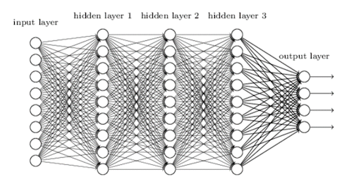
数据纵向增长：语义的丰富
embeddings
语义丰富
embeddings
embeddings

Slide 7
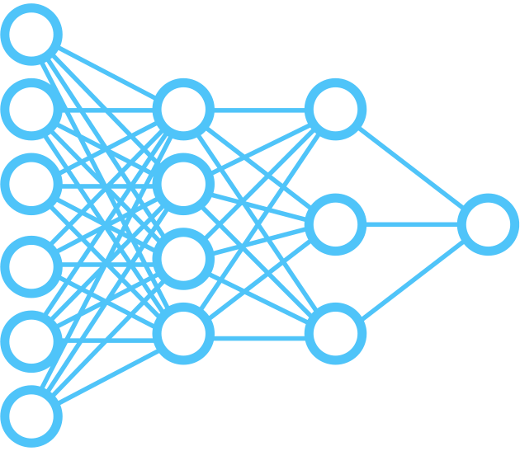
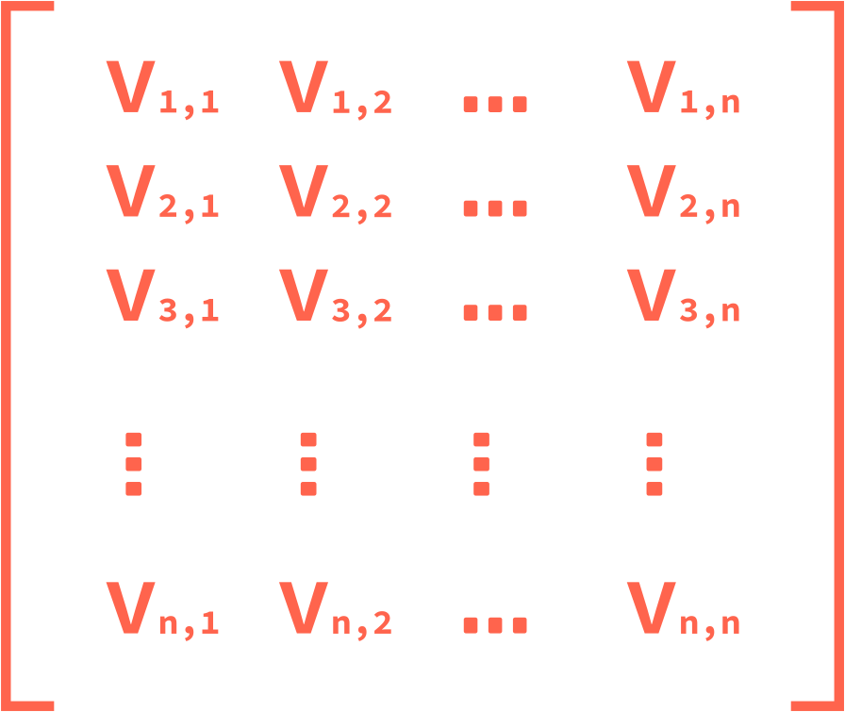




非结构化数据处理流程
Geospatial Data Analysis Engine
Arctern
Model Zoo, Data Hub & AI Community
Towhee (Phantoscope)
Vector Database
Milvus/Py-Milvus/Knowhere/Autonomous/Enterprise Manager
非结构化数据
深度学习模型
Embedding vectors
信息知识 价值

Slide 8
Milvus不是什么
Milvus 不是关系型数据库
Milvus 不是搜索引擎
Milvus 不是算法库

Slide 9
Milvus是什么
Milvus 是向量数据库
Milvus 提供向量空间的距离相似搜索
Milvus 提供一套完整的存储/索引/搜索解决方案

Slide 10

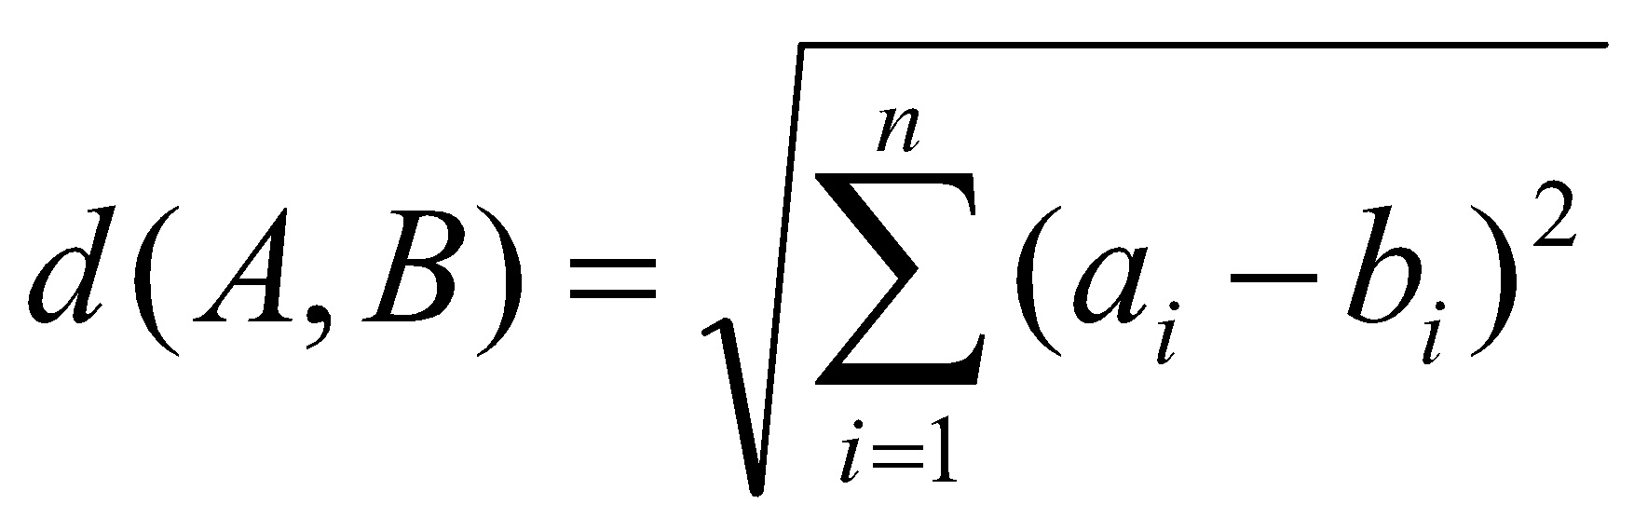
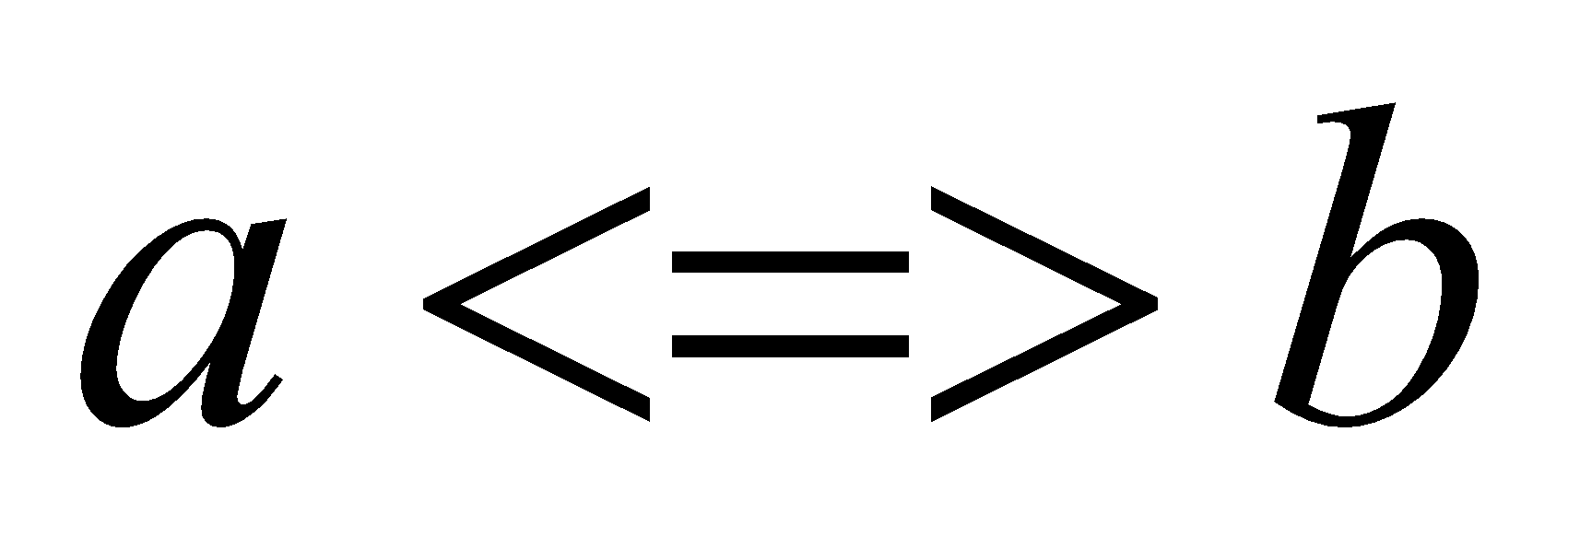
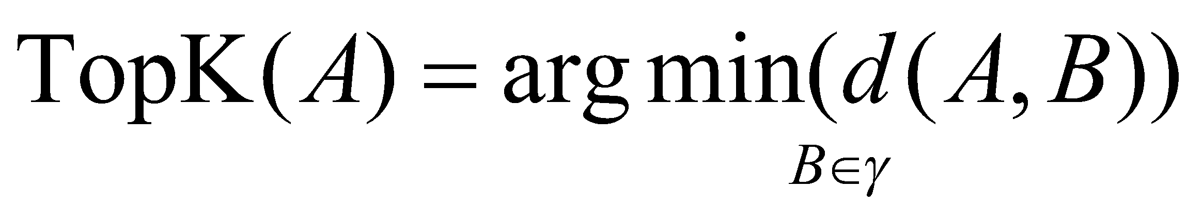
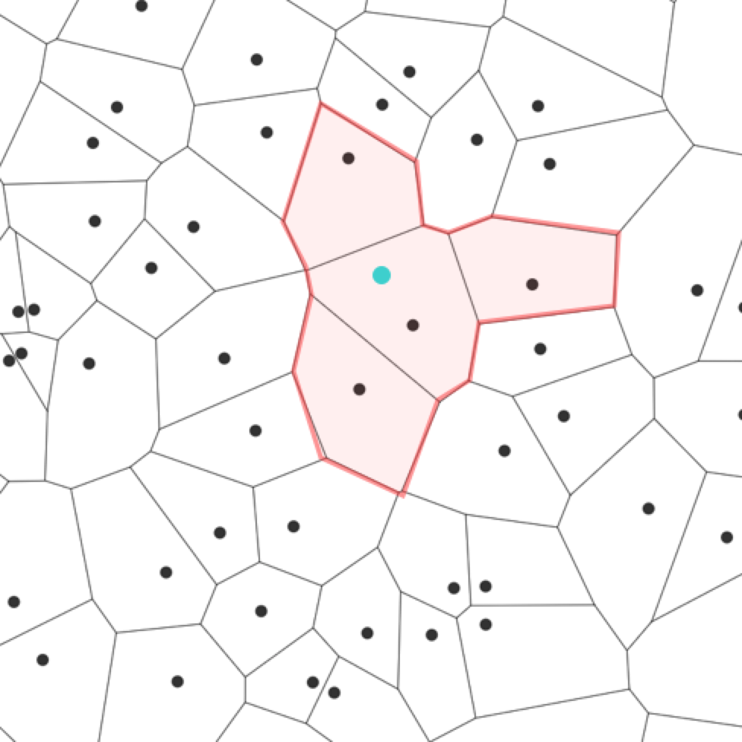
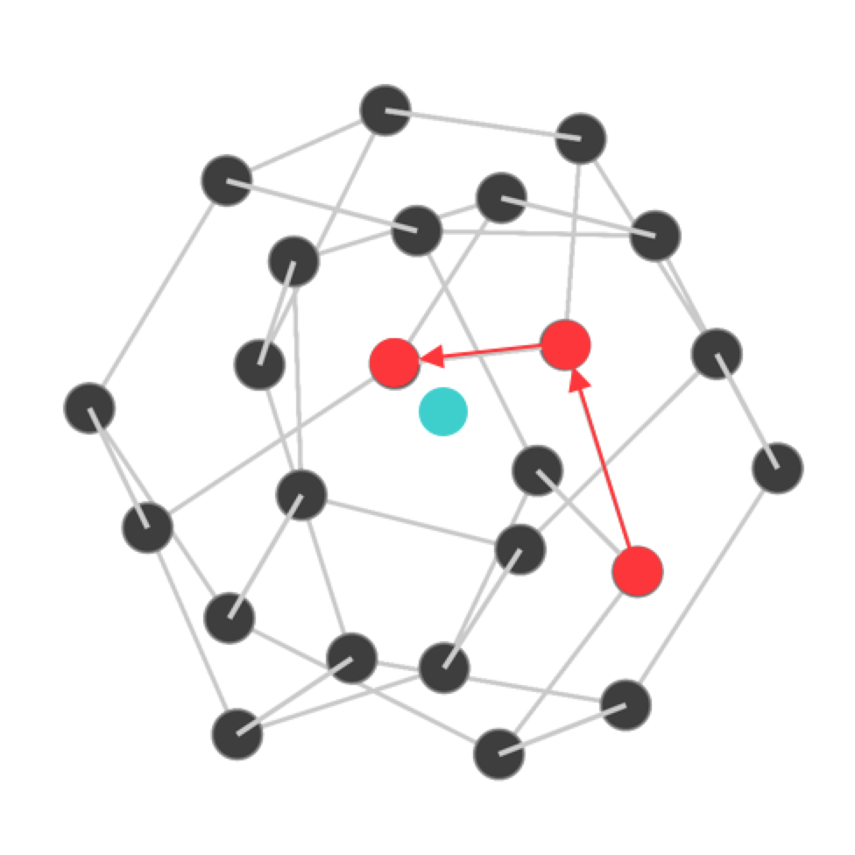
标量
向量
算数操作 标量比较
相似度(eg.欧氏距离) 相似度比较
Operation
1–10
1–5
6–10
Organization
1 2 3
4 5
6 7
8 9 10

Slide 11
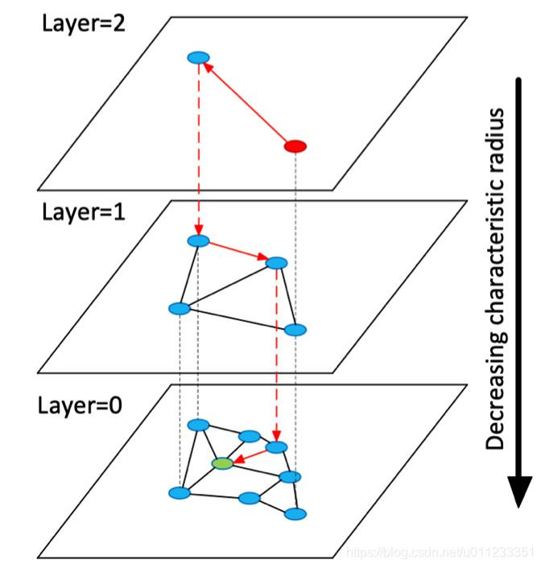
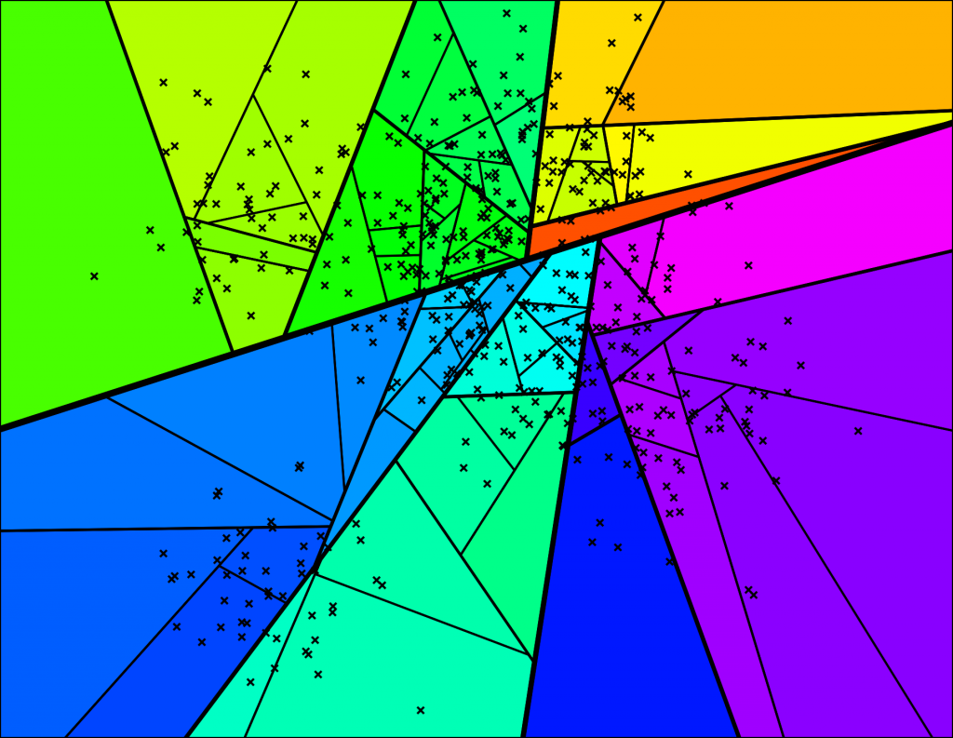
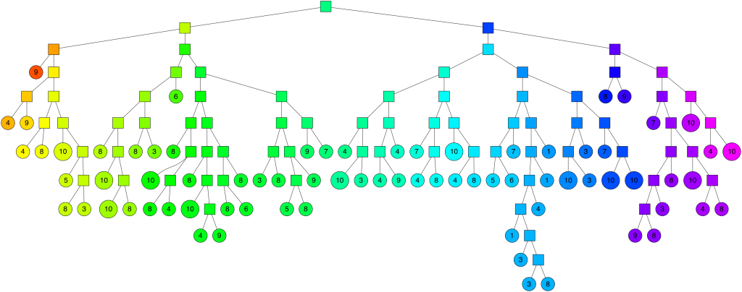
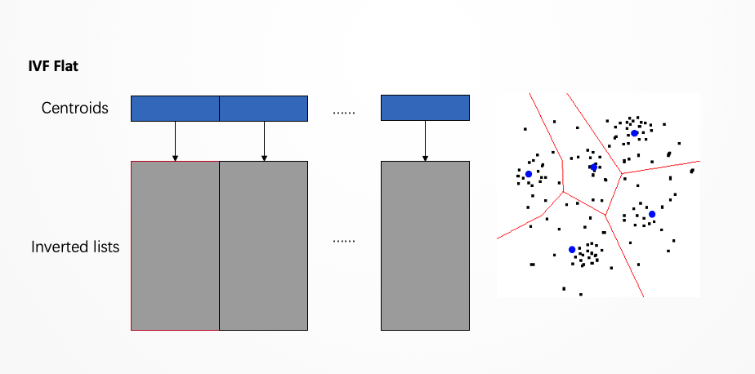
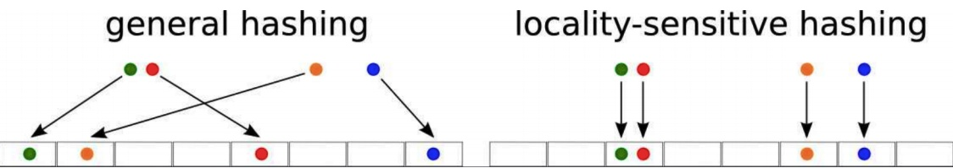
常见的向量索引类型
暴力搜索
基于哈希: FALCONN
基于树: ANNOY
基于倒排文件索引: FAISS
基于图: HNSW

Slide 12
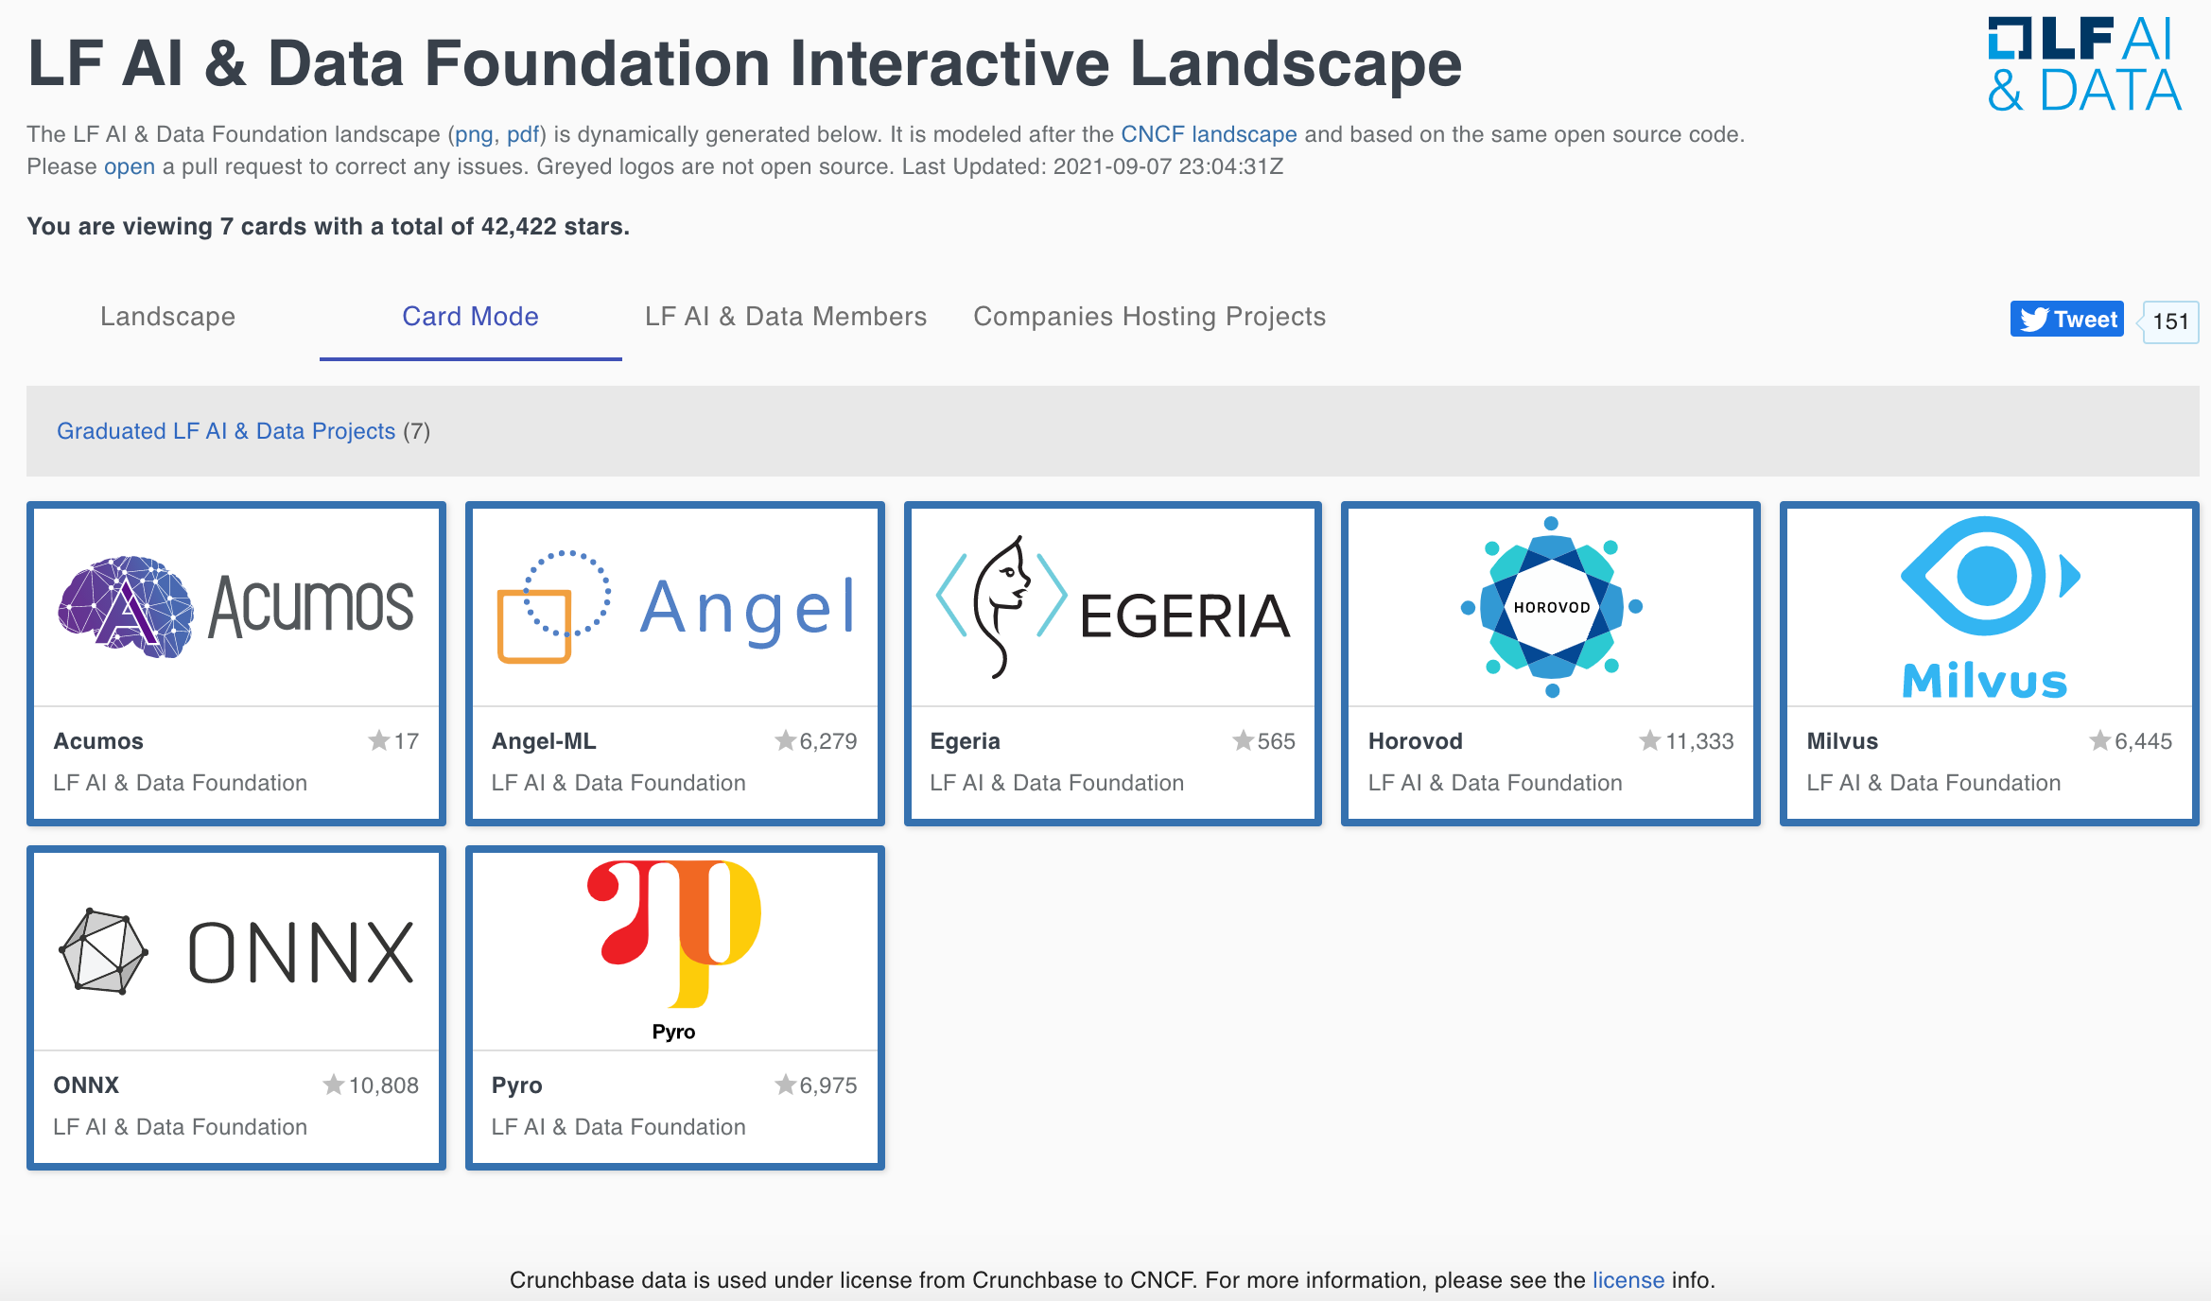
Milvus 是 LF AI &Data 毕业项目

Slide 13
02
Milvus1.0 =>2.0
Go！

Slide 14

从1.X 到2.0
C/C++ => Go
单机应用 => 分布式 & cloud native
向量搜索 => 标量向量混合查询
近实时 => 多种一致性
https://github.com/milvus-io/milvus/blob/master/milvus20vs1x.md

Slide 15


Why Go
效率？
易用？
成本？

Slide 16
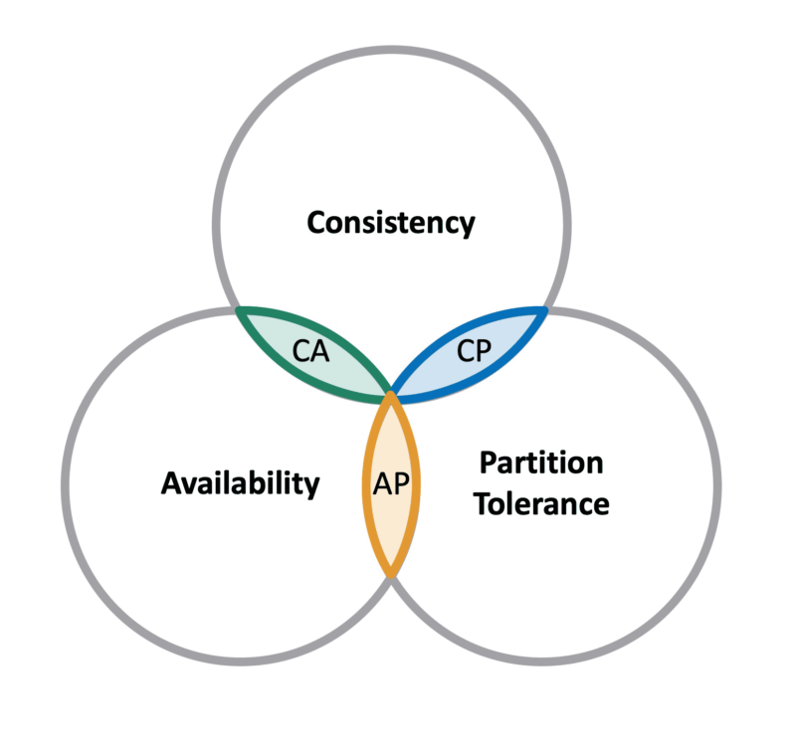
CAP

Slide 17
New CAP
Cost
Accuracy
Performance

Slide 18
2018.10
2019.04
2019.06
Milvus 0.1
Release
1st Seed
User
The Idea
2021.06
2019.10
2020.03
2021.03
Milvus 2.0.0rc1 Release
Open
Source
Joined
LF&AI
Milvus 1.0
Release

Slide 19
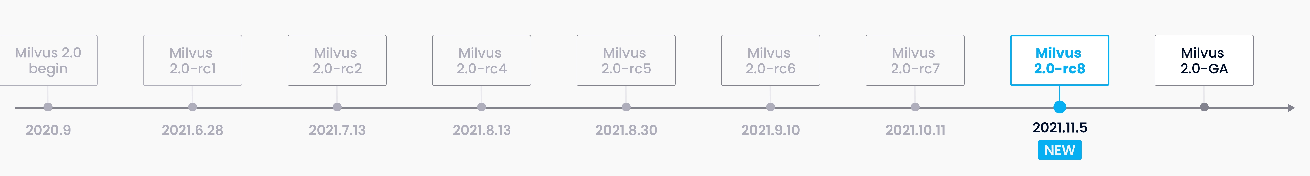
2018.10
2019.04
2019.06
Milvus 0.1
Release
1st Seed
User
The Idea
2021.06
2019.10
2020.03
2021.03
Milvus 2.0.0rc1 Release
Open
Source
Joined
LF&AI
Milvus 1.0
Release

Slide 20
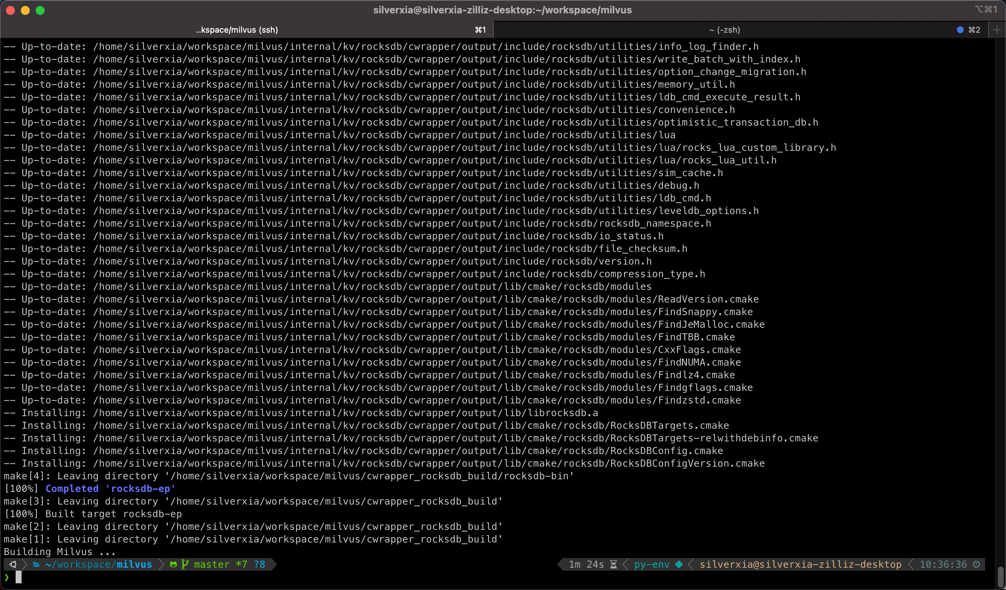
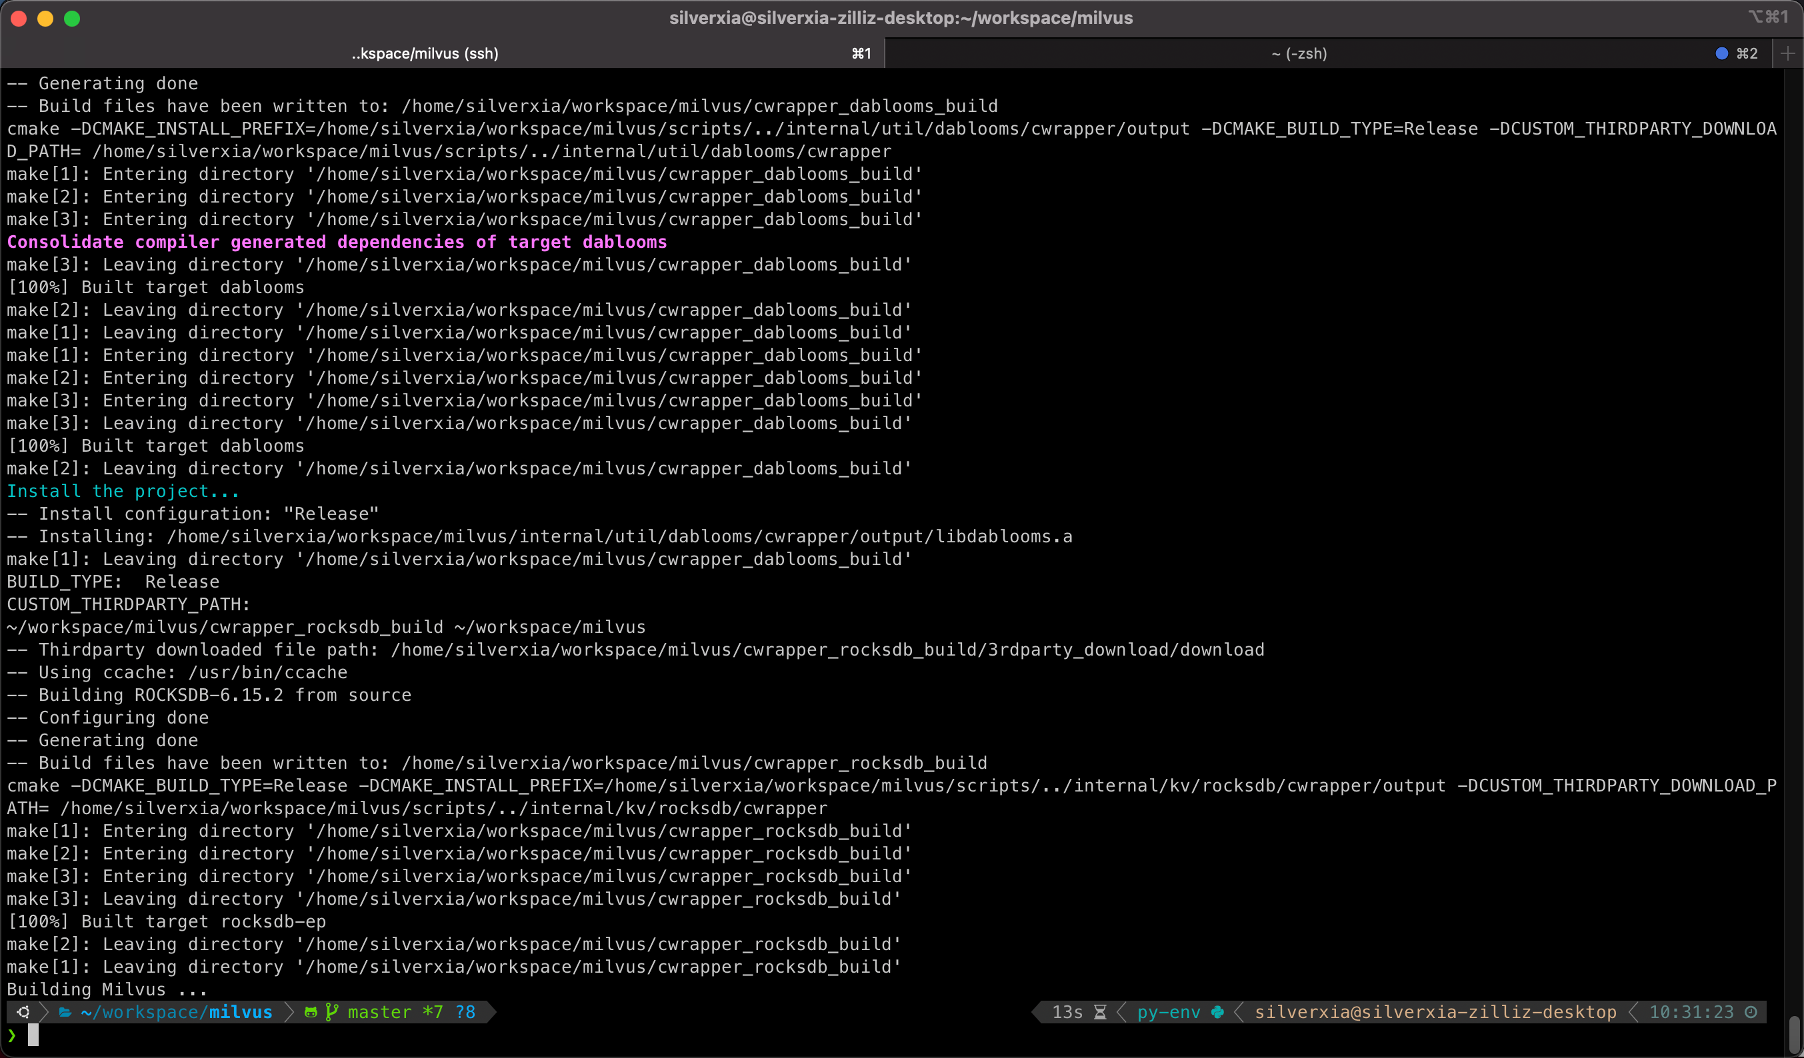

Slide 21
03
Milvus2.0的设计

Slide 22
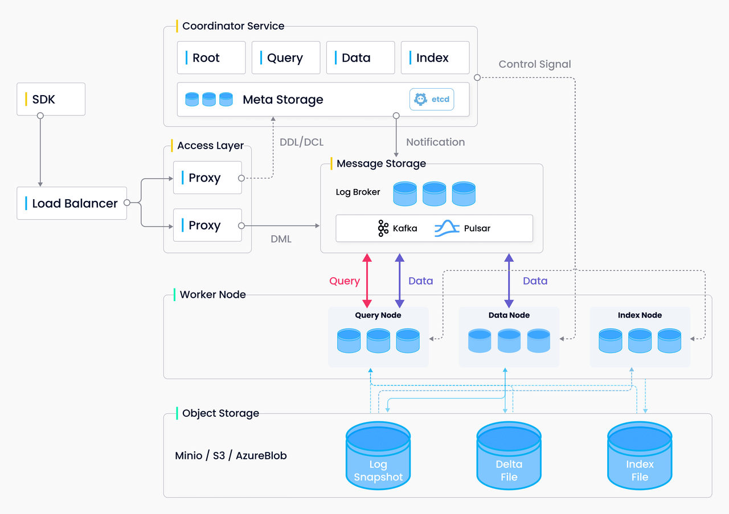

Slide 23
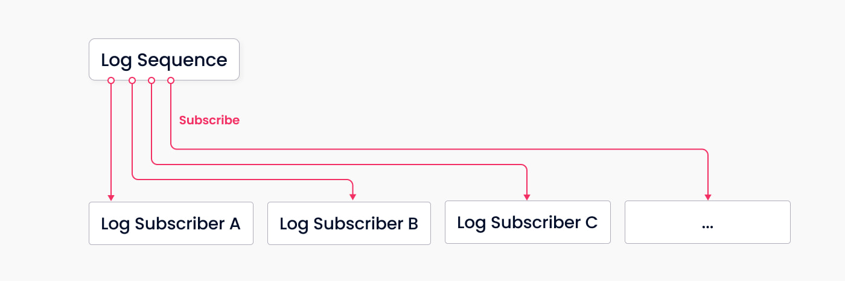
系统的主干 - 日志系统
解耦快照存储和日志流，解耦读写链路
断点恢复逻辑简单
可扩展
降低组件复杂度

Slide 24
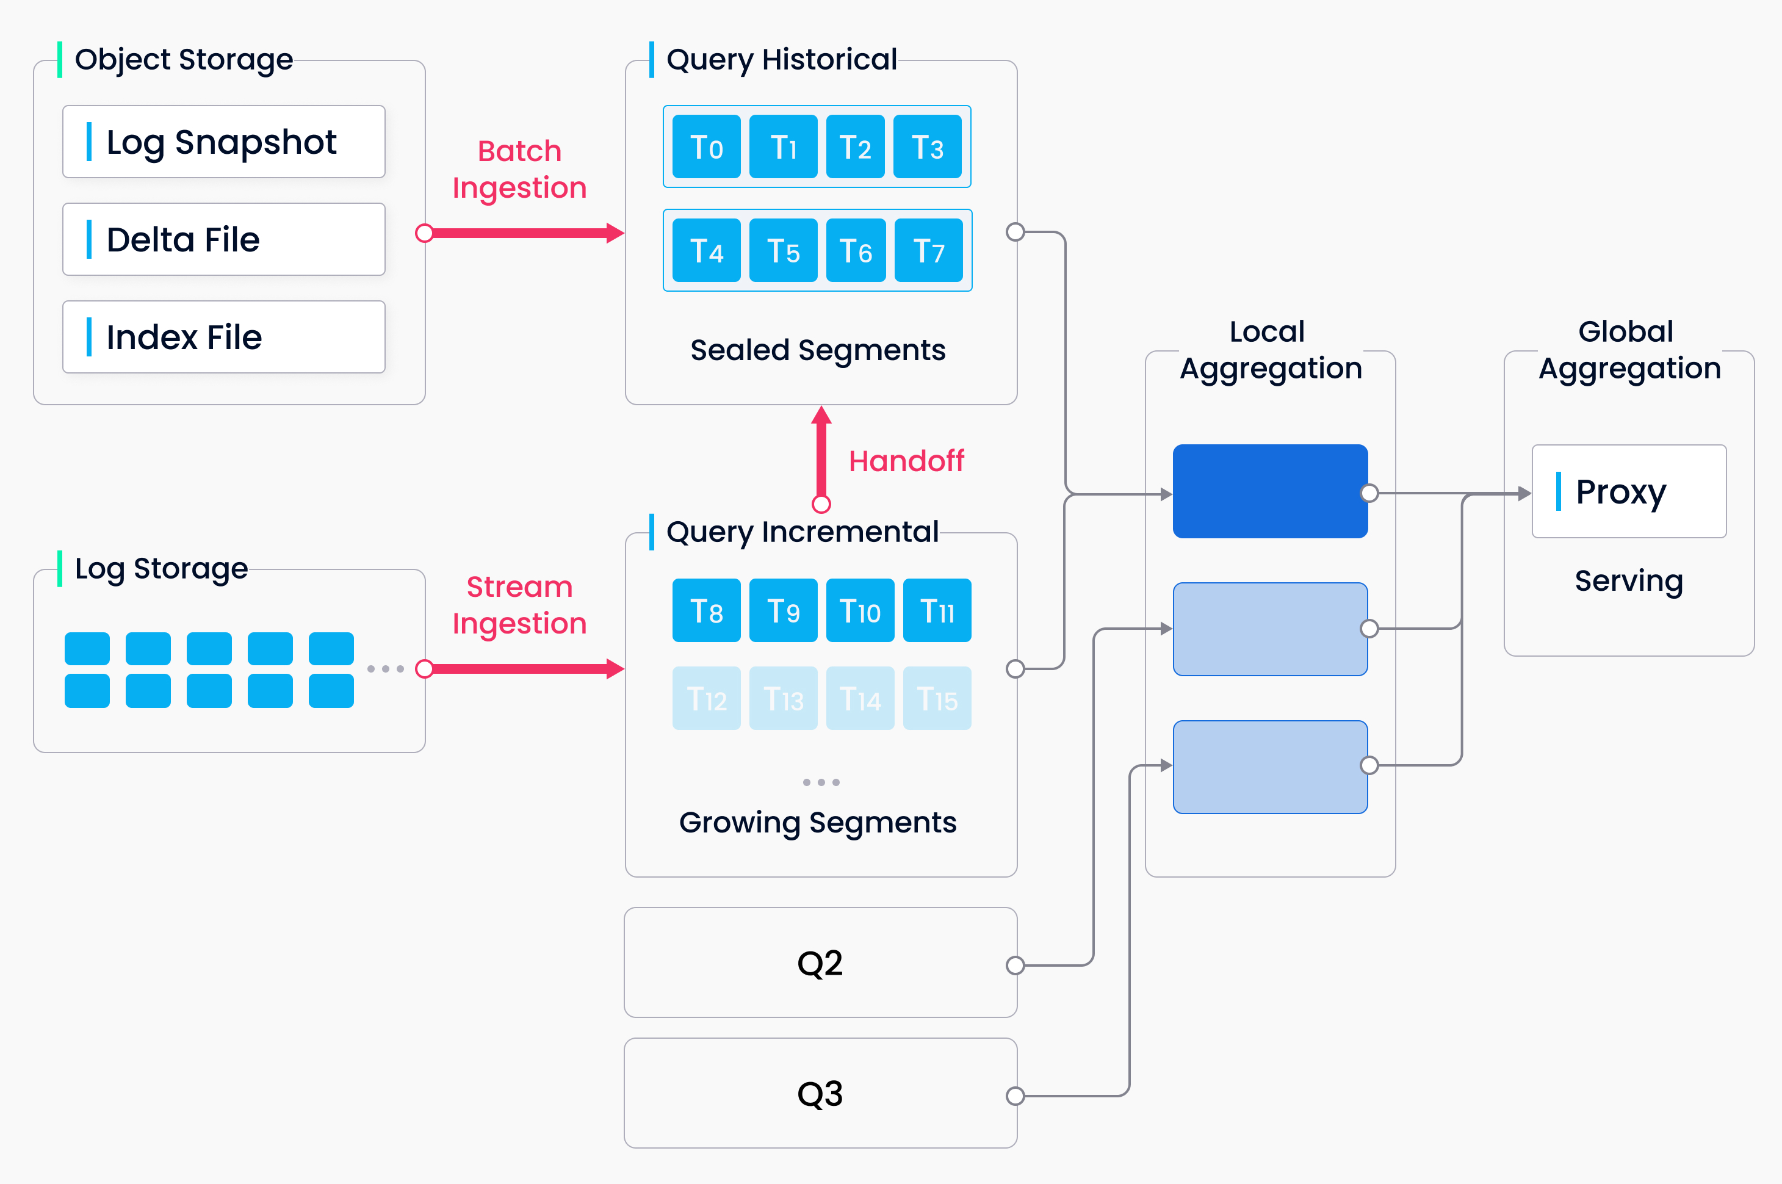
流批结合
全量消费日志不是实际操作的解决方案
解决方案
定期将数据持久化到称做segment的文件单位中（类似LSM树的flush），并通过Hand-off
机制将对应的状态从Growing变为Historical。
根据时间戳合并历史（Historical-batch）和新增数据（Growing-stream）保证数据的完整性
Time tick
Time tick
Window 1
Window 2
1
2
6
5
8
9
10

Slide 25

Coordinators
Log Broker
Log Subscribers
Storage

Slide 26
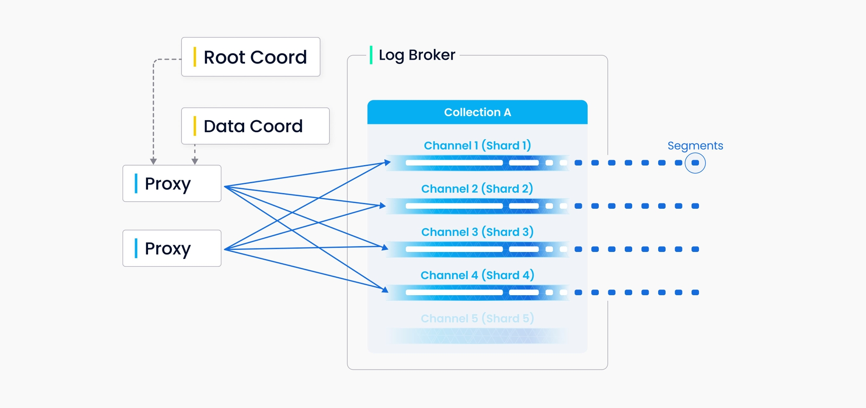
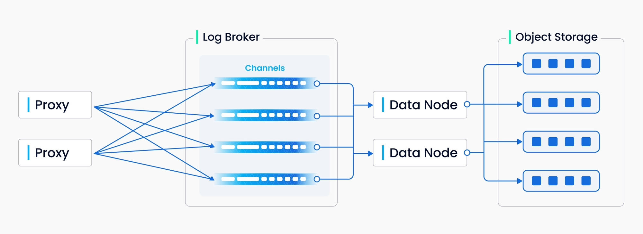
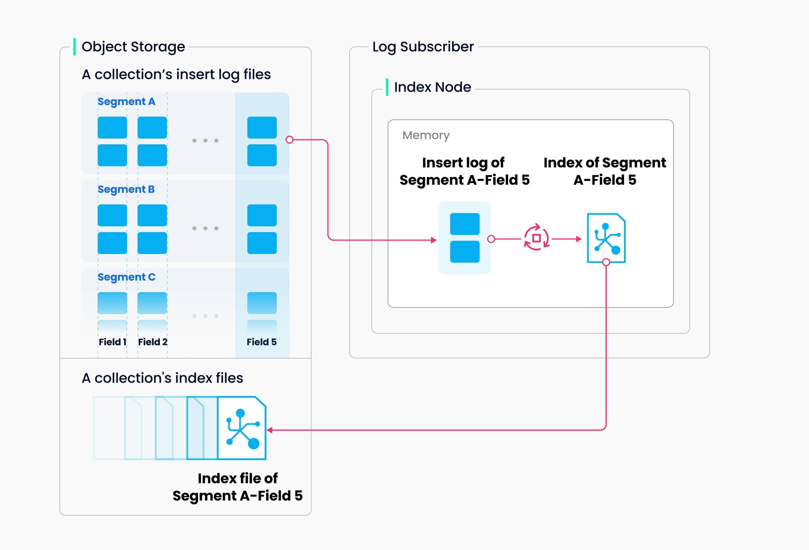
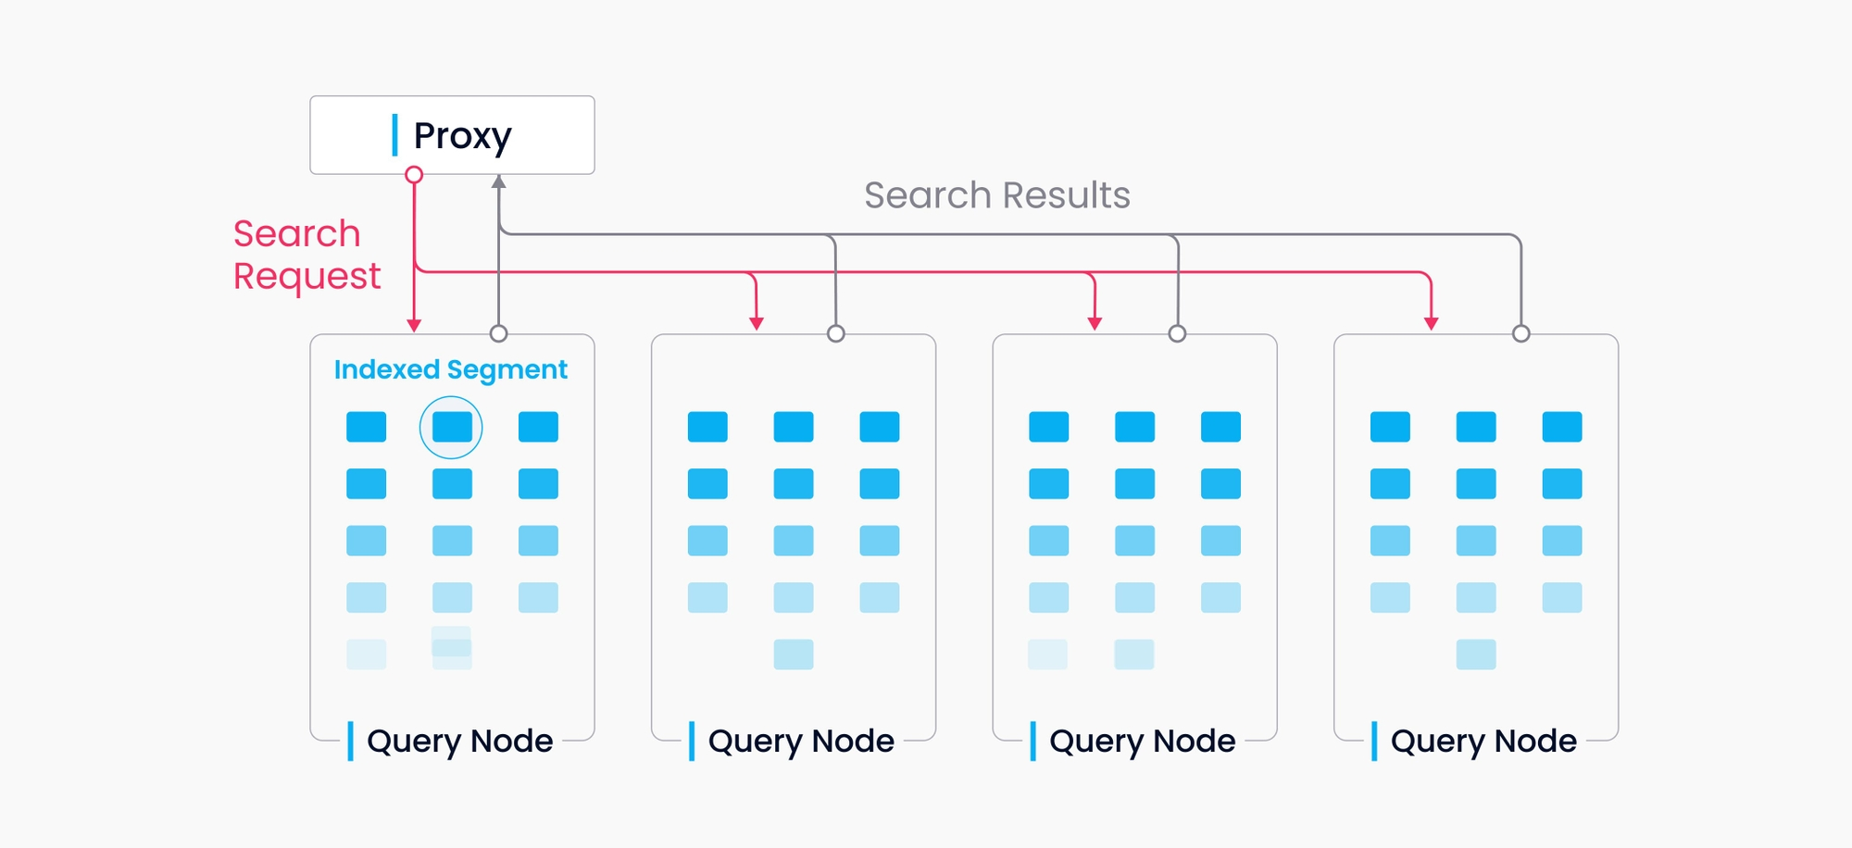
链路之间的解藕

Slide 27
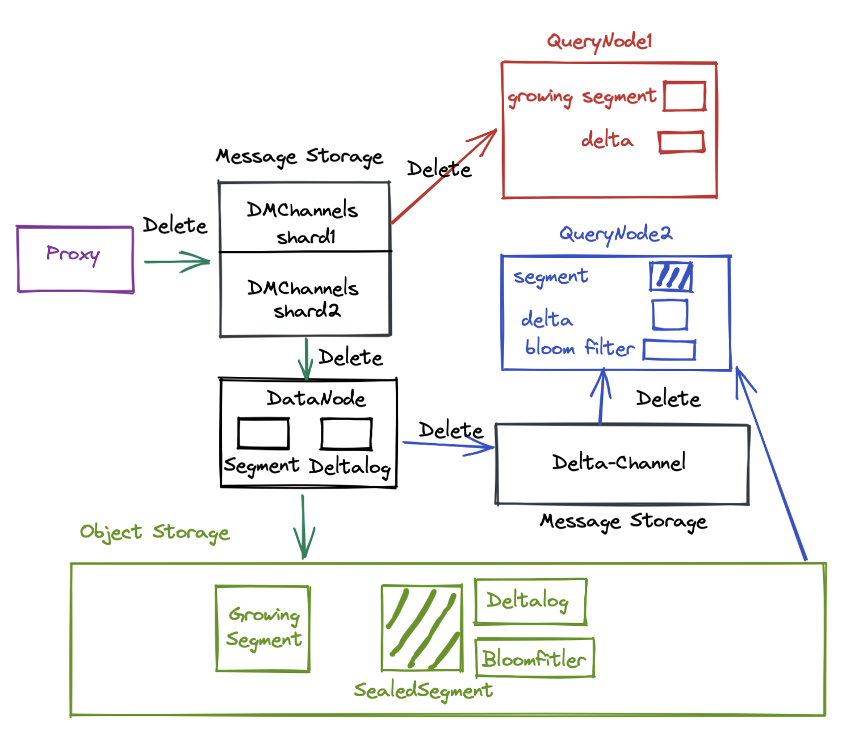
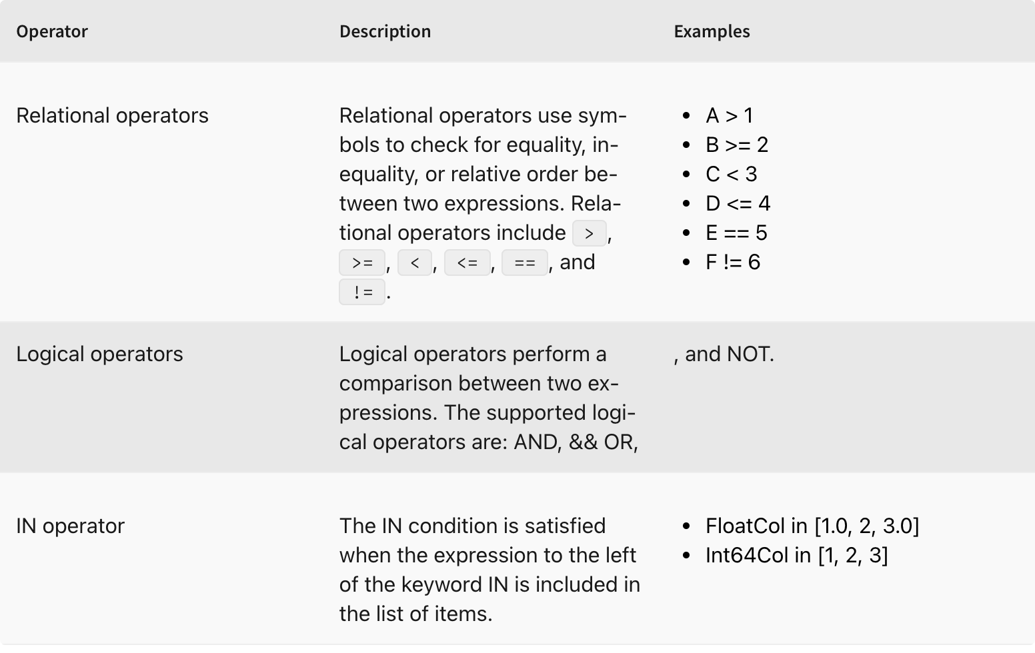
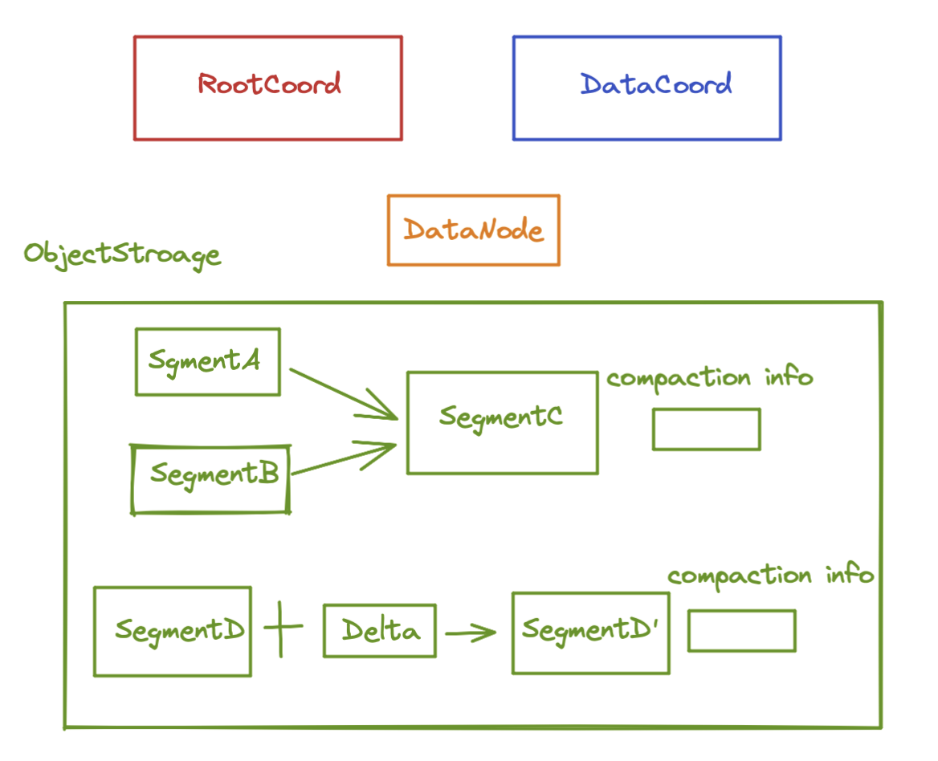
2.0新特性
Delete（实现中）
Segment Compaction（实现中）
布尔表达式混合搜索（已实现）
String 数据类型（2.1+）

Slide 28
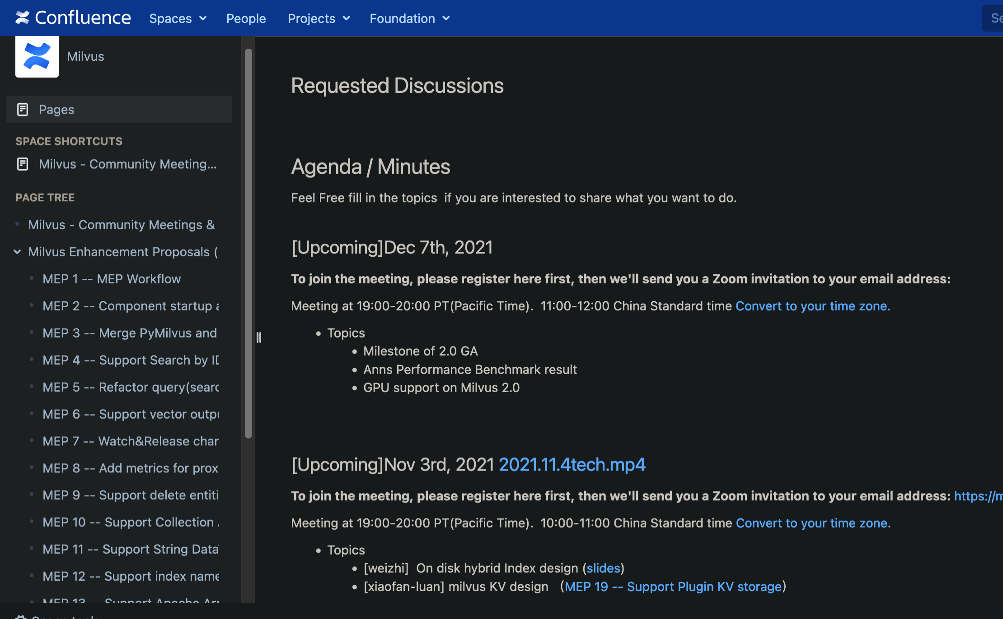
Tech Meeting & Milvus Enhancement Plan
https://wiki.lfaidata.foundation/pages/viewpage.action?pageId=43287103
https://wiki.lfaidata.foundation/pages/viewpage.action?pageId=43287098

Slide 29
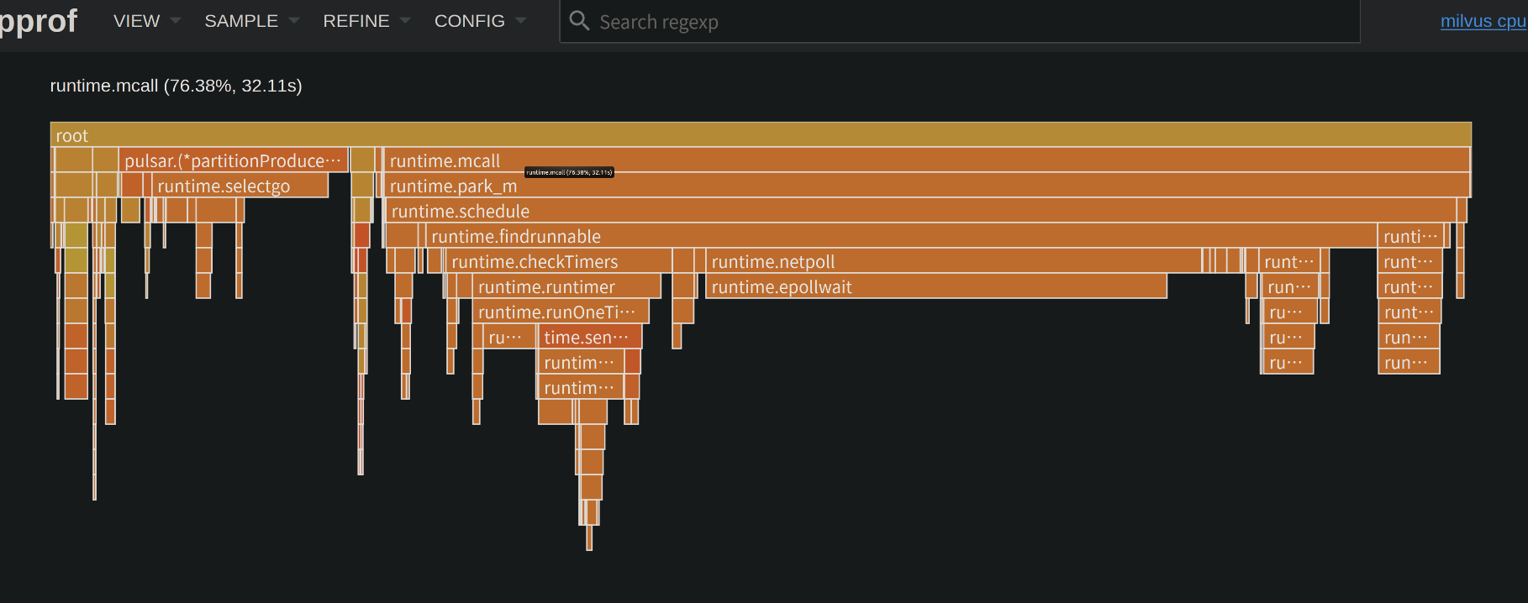
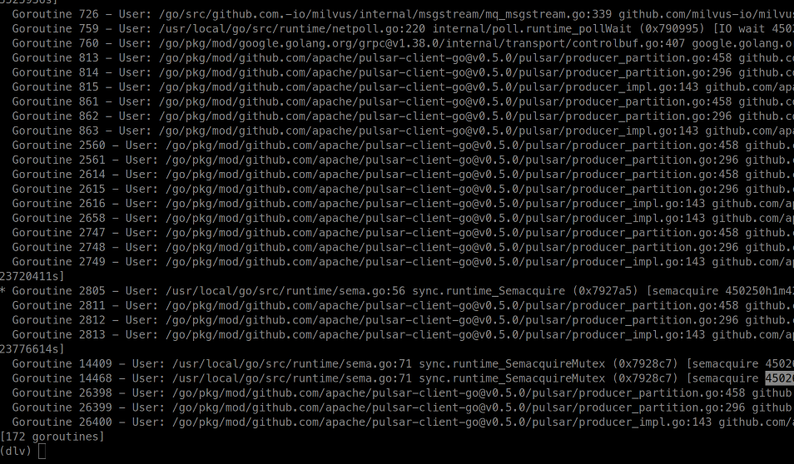
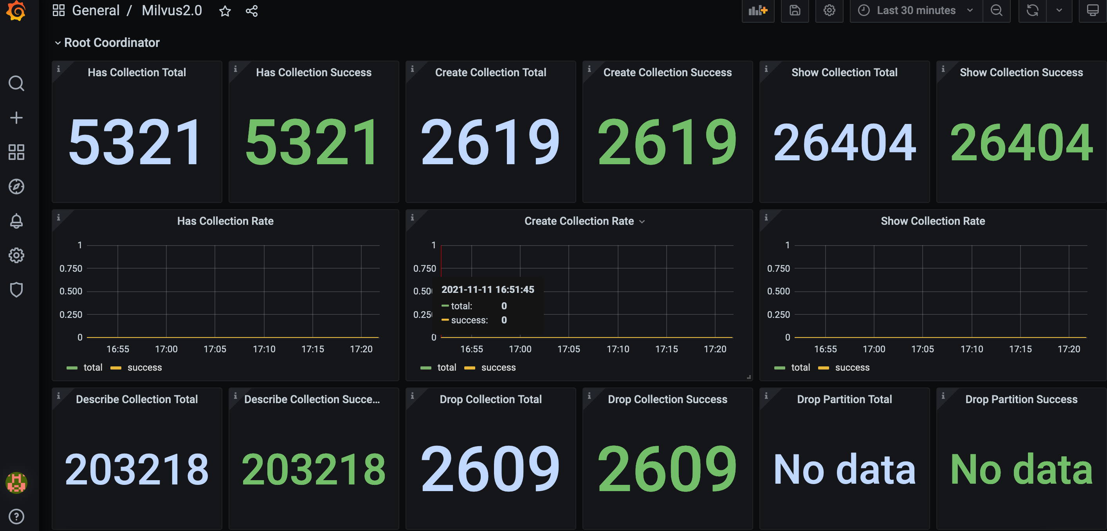
Debug & Metrics
CGO Batching 批量提交数据
限制/隔离Golang 和 C的内存分配
dlv + gdb
pprof提供go的不在场证明
Metrics 监控

Slide 30
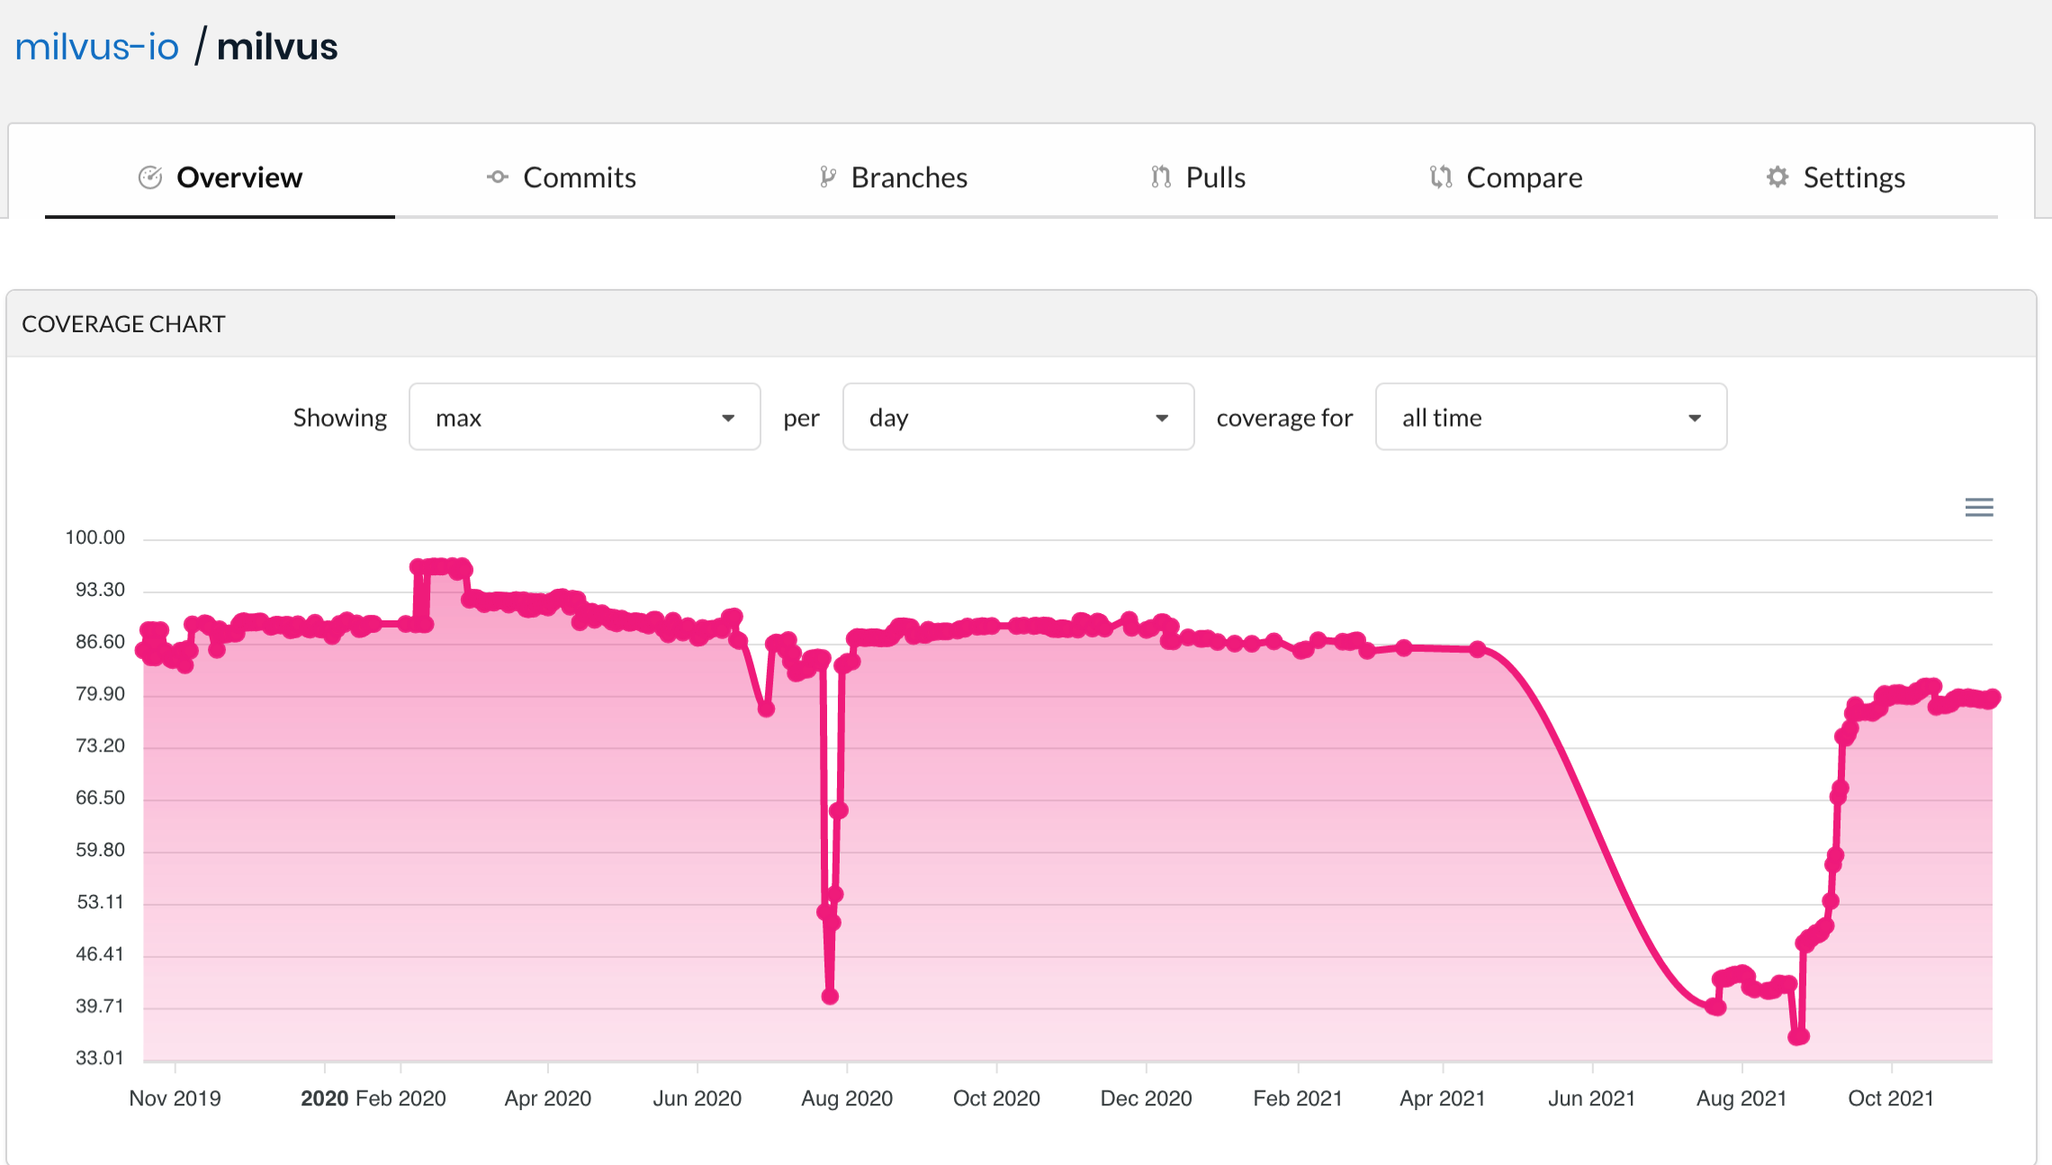
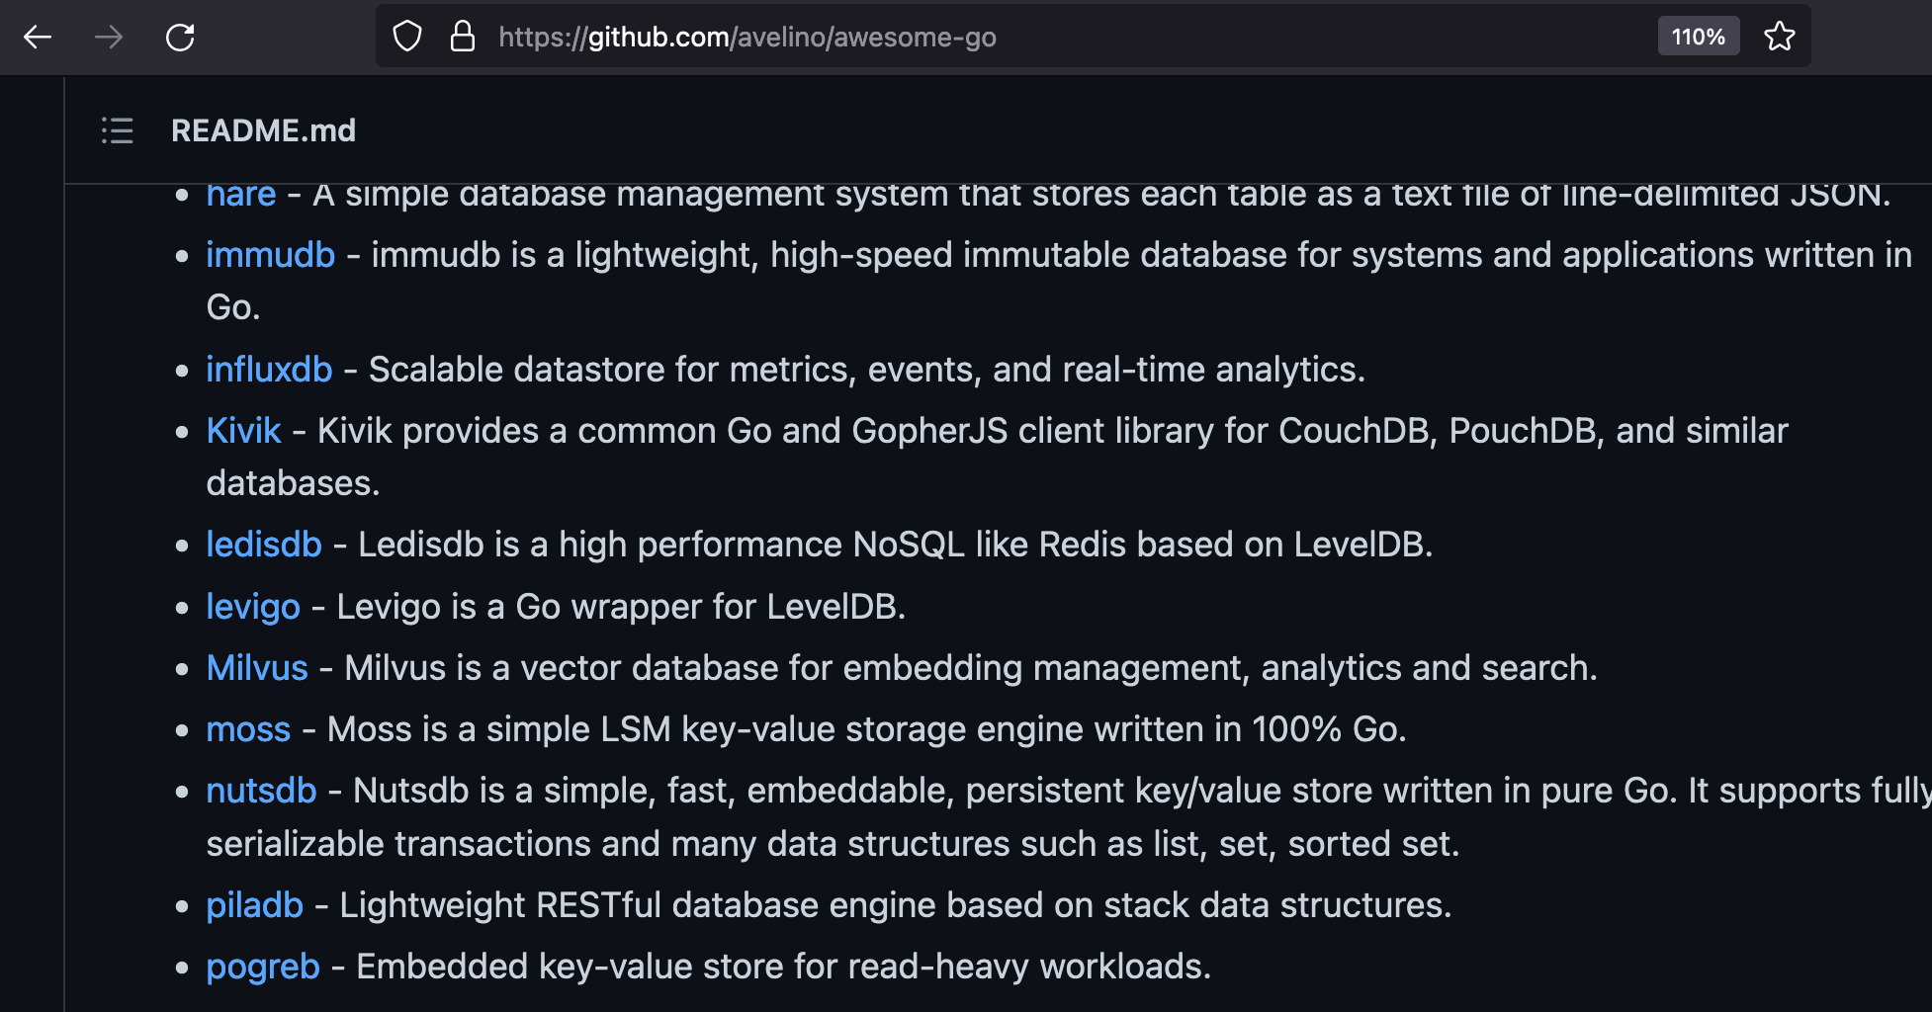
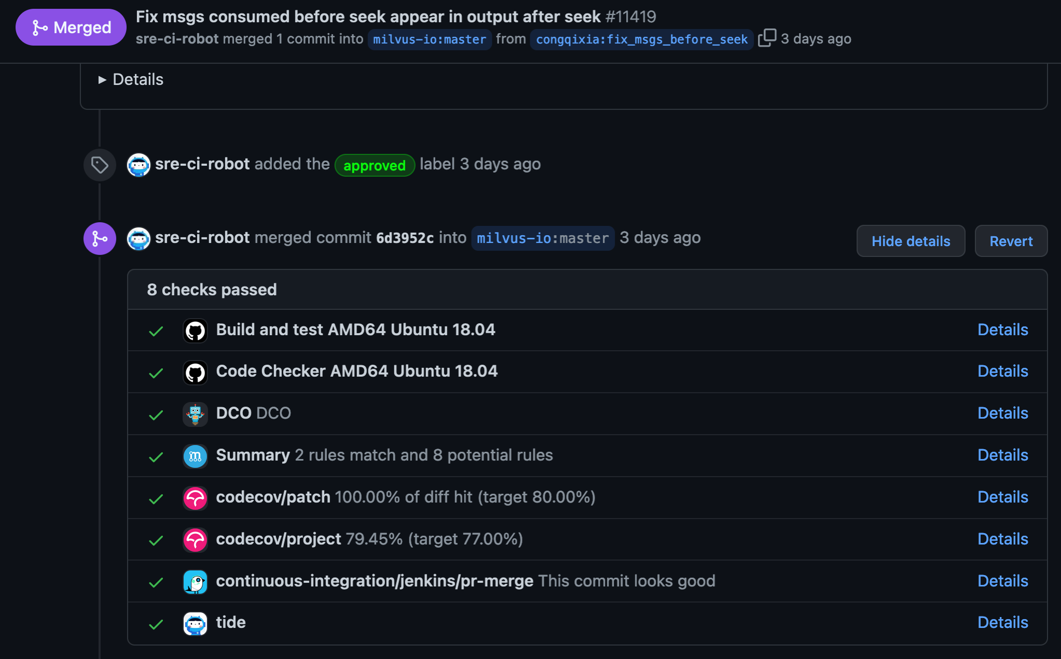
代码质量 & 测试
Unit tests 覆盖率
e2e 测试
chaos 测试
scaling/benchmark测试

Slide 31
04
一些用户案例

Slide 32














































全球企业用户

Slide 33

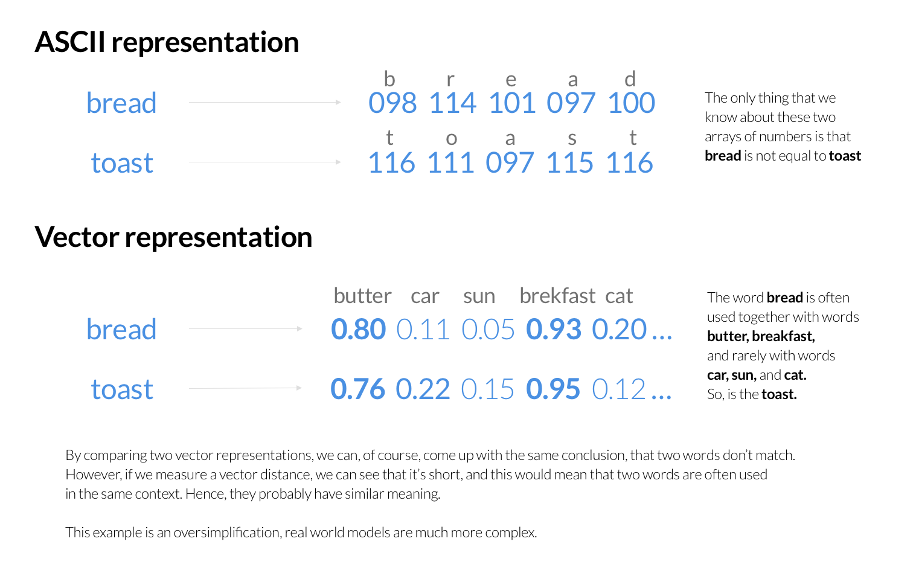
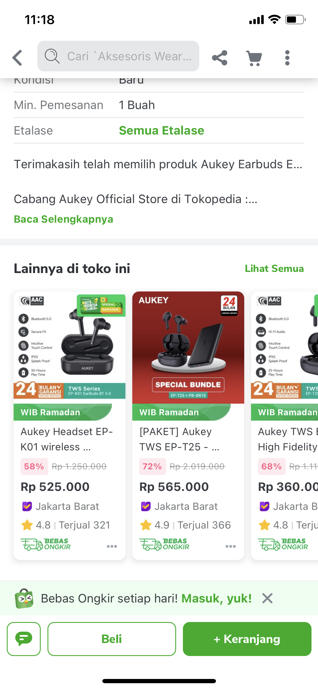
相关产品搜索、推荐
普通的Elastic search如果没有语义插件解决方案
对于上文的两个单词Bread Toast，会认为是两个不同的物品
假设类似的上下文表述类似的事务。那么我们能把整句话，或者这个物品的描述，处理成一个向量
Notes:
The first use case was by Tokopedia, one of the largest e-commerce services in Indonesia.
They needed an updated search engine, they were using Elastisearch to match raw keywords within product names and descriptions.
This works for finding documents that use the same words repeatedly, but doesn’t always mean that they are similar.
The new method is to generate word embeddings vectors using the product names and descriptions.
Word embeddings replace words with vectors that map to areas of similarity between words.
These word embeddings can then be put into milvus and a similarity search can then be performed to find products that relate.

Slide 34
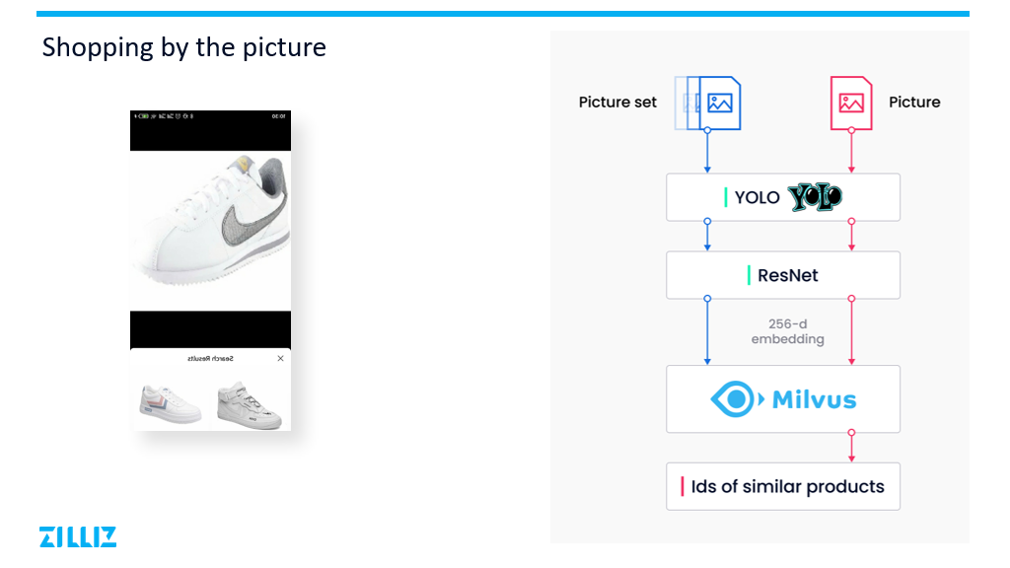

Notes:
Another application of milvus that is popular with our users is a reverse image product search.
In the case, the user used 2 neural nets to pull out an embedding.
The first neural net was a tuned yolo net for object detection and the next net was resnet for image embedding
With these embeddings in milvus, a similarity search can be performed on images to find the closest matches

Slide 35
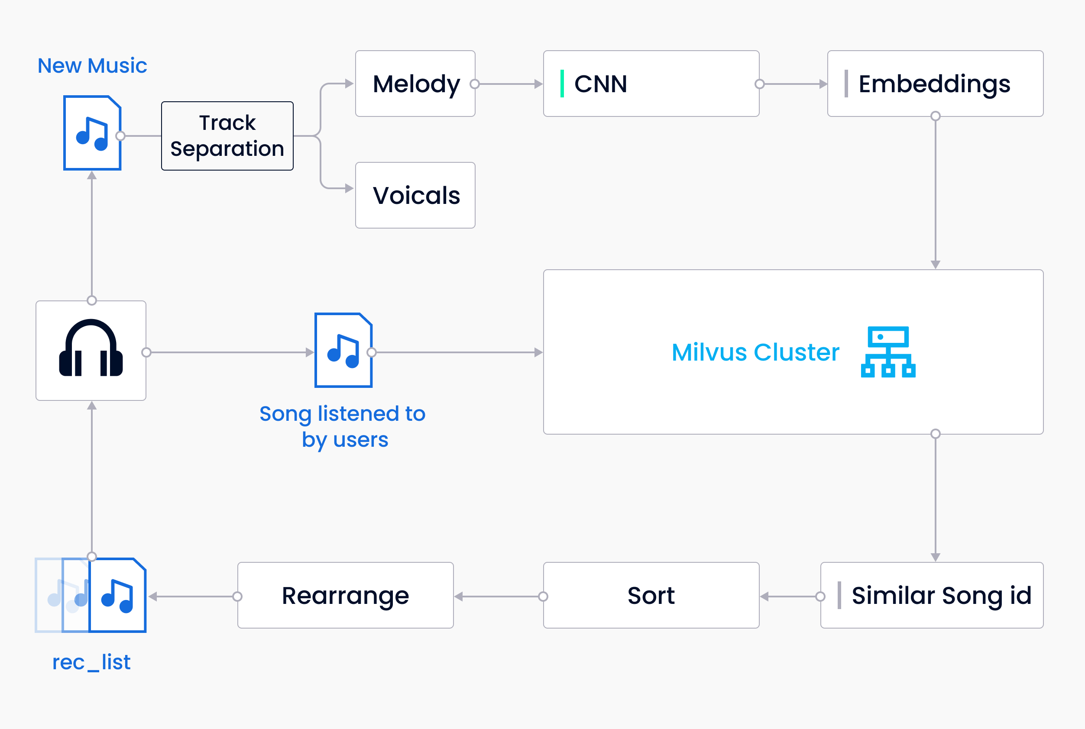
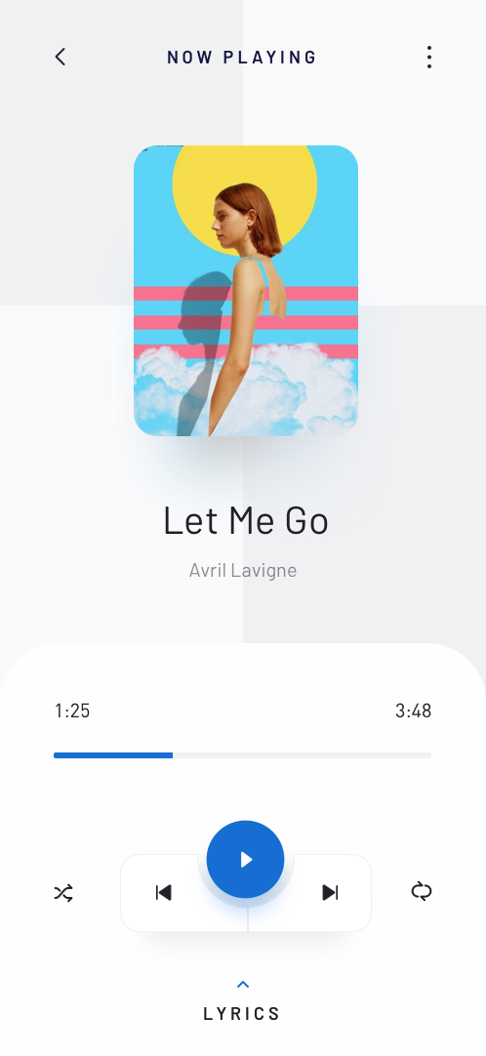
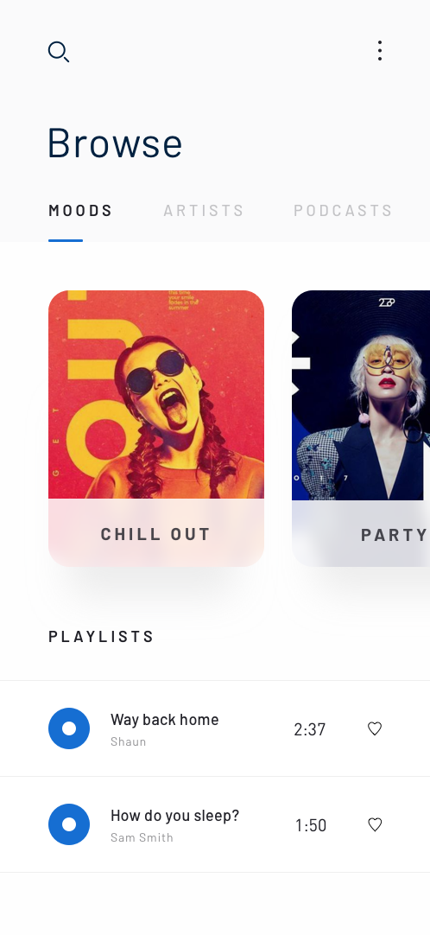
音乐推荐
Notes:
Another interesting use case is for Music recommendations
The first step for encoding a song is to separate the background music and the vocals. This is done using techniques such as audio inversion.
The next step is to get embeddings built up from the background music. The background music is used due to having more information about the song and to avoid missclustering due to Cover versions having different vocals for songs.
With these embeddings stored in milvus we can search the current song the user is listening to to find similar songs. In order to avoid having songs that are too familiar, you can sort the results backwards to give a similar but not same song.

Slide 36




Thank You!
https://milvus.io
https://github.com/milvus-io/milvus
https://twitter.com/milvusio

